Slide 1
Module- 2
Performance appraisal

Slide 2
Content to be discussed
Meaning
Objective
Process and methods
Potential appraisal
Biases in performance appraisal
Methods of job evaluation
Meaning of compensation
Types of compensation
Types of wages and theories
Wage differentials
Pay structure
Wage law in India
Executive compensation

Slide 3
YemBees A story
Once upon a time in Yemen, there were two beekeepers who each had a beehive. The beekeepers worked for a company called YemBees Ltd.
The company’s customers loved its honey and wanted the business to produce more honey than it had the previous year.
As a result, each beekeeper was told to produce more honey at the same quality.

Slide 4
YemBees A story
With different ideas about how to do this, the beekeepers designed different approaches to improve the performance of their hives.
YemBees - Beekeeper 1
The first beekeeper established a bee performance management approach that measured how many flowers each bee visited. At considerable cost to the beekeeper, an extensive measurement system was created to count the flowers each bee visited.
The beekeeper provided feedback to each bee at midseason on his individual performance, but the bees were never told about the hive’s goal to produce more honey so that YemBees Ltd could increase honey sales.
The beekeeper created special awards for the bees who visited the most flowers

Slide 5
YemBees A story
YemBees - Beekeeper 2
The second beekeeper also established a bee performance management approach but this approach communicated to each bee the goal of the hive for increased honey production. The beekeeper and his bees measured two aspects of their performance:
the amount of nectar each bee brought back to the hive
and the amount of honey the hive produced.
The performance of each bee and the hive's overall performance were charted and posted on the hive's bulletin board for all the bees to see.
The beekeeper created a few awards for the bees that gathered the most nectar.
But he also established a hive incentive program that rewarded each bee in the hive based on the hive's overall honey production the more honey produced, the more recognition each bee would receive.

Slide 6
The result of beekeeper 1 and his team
At the end of the season, the beekeepers evaluated their approaches. The first beekeeper found that his hive had indeed increased the number of flowers visited, but the amount of honey produced by the hive had dropped.
The Queen Bee reported that because the bees were so busy trying to visit as many flowers as possible, they limited the amount of nectar they would carry so they could fly faster.
Also, since only the top performers would be recognized, the bees felt they were competing against each other for awards.
As a result, they would not share valuable information with each other that could have helped improve the performance of all the bees (like the location of the flower-filled fields they'd spotted on the way back to the hive).
As the beekeeper handed out the awards to individual bees, unhappy buzzing was heard in the background.
(After all was said and done, one of the high-performing bees told the beekeeper that if he'd known that the real goal was to make more honey, he would have worked completely differently.)

Slide 7
The result of beekeeper 2 and his team
The second beekeeper, however, had very different results.
Because each bee in his hive was focused on the hive's goal of producing more honey, the bees had concentrated their efforts on gathering more nectar in order to produce more honey than ever before.
The bees worked together to determine the highest nectar yielding flowers and to create quicker processes for depositing the nectar they'd gathered.
They also worked together to help increase the amount of nectar gathered by the poorer performers.
The Queen Bee of this hive reported that the poor performers either improved their performance or transferred to hive #1. Because the hive had reached its goal, the beekeeper awarded each bee his portion of the hive incentive payment.
The beekeeper was also surprised to hear a loud, happy buzz and a jubilant flapping of wings as he rewarded the individual high-performing bees with special recognition.

Slide 8
Learning from story
Accomplishment (honey production) Vs. Activities (visiting flowers)
Activities are the actions taken to produce results.
Accomplishment is the output.
This out put will have to measure.
Here the importance of appraisal comes.
organisation measures the output( accomplishment) in two way.
Employees level ( bees)
Work unit level (beekeepers)

Slide 9
Performance appraisal
It is the process of evaluating the employee’s performance on the job in terms of requirements of the job. By Scott
What do we need to evaluate a person’s performance?
1. job description
2. clear goal
3. measurement parameters
4. desired outcomes ( quantity & quality)

Slide 10
How to link appraisal output with organisational corporate value?
Organisation corporate value:
It is an operating philosophies or principles that guide an organization's internal conduct as well as its relationship with its customers, partners, and shareholders.
Broadly organisation corporate values are: customers, employees, society, products.
All this values are translated into performance measures use in appraisal system.

Slide 11
Appraisal formats
Commonly used performance appraisal formats include:
Global ratings: this includes “ one-dimensional rating system” that uses a rater’s overall estimate of performance ( poor, fair, good, excellent)
Trait based scales: this is a multidimensional approach used to measure and evaluate performance. Common traits are : loyalty, dependability, cooperation, initiatives and self-confidence.
Effectiveness-based systems: this is a system based on “objective "results representing the contribution of employees.

Slide 12
How plan for the appraisal
A meaning full performance appraisal is a two-way process.
Appraisal strategy:
1. before the appraisal: before the beginning of the appraisal process the organisation needs to ensure the following aspects namely:
Establish key task areas and performance goals
Set performance goals
Get the facts
Schedule appraisal interview.
2. During Appraisal: during this emphasis is begin given on the following aspects namely:
Encourage two-way communication
Discuss and agree on performance goals for the future
To think about how one can assist the employee to achieve more at work.
Record notes of the in interview
3. After the appraisal: this involves the following aspects namely:
Preparing a formal record of the performance interview discussion
Monitor performance
Identify areas of performance improvement.

Slide 13
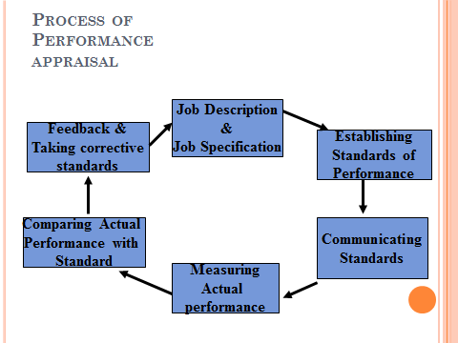
Process of appraisal

Slide 14

The Performance Appraisal Process
Steps in the performance appraisal process
Establish performance standards
These are benchmarks against which performance is measured.
They should relate to the desired results of each job
They must be clear to both the appraiser and the appraisee.
Good performance goals should speak about
What is the task to be accomplished?
What will it look like when it is accomplished?
When must it be completed?
What are the cost considerations?
What are the likely payoffs to the employee?
Performance And Potential Appraisal

Slide 15
The Performance Appraisal Process
Communicate the standards
The Appraiser should prepare job descriptions clearly
Help the appraisee set own goals and targets
Analyse results objectively
Offer coaching and guidance
The Appraisee should be clear about what he is doing and why he is doing
Performance And Potential Appraisal

Slide 16
The Performance Appraisal Process
Measure actual performance
Use reliable and dependable performance measures
These must be easy to use and report on critical behaviours that determine performance
These would generally include: personal observation, statistical reports, oral reports and written reports
These may be objective or subjective
Objective measures are generally quantitative, and include quality of production, degree of training needed, accidents in a given period, absenteeism, length of service etc. Such measures are used for evaluating lower level jobs
Subjective measures are based on opinions of those doing evaluation and are not verifiable by others; generally used for evaluating middle level positions.
Performance And Potential Appraisal

Slide 17
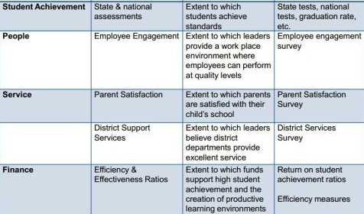
PERFORMANCE MEASURE MEANS
PERFORMANCE GOAL | PERFORMANCE MEASURE | OBJECTIVE | TOOL

Slide 18
The Performance Appraisal Process
Compare actual performance with standards and discuss the appraisal
Take corrective action, if necessary
Performance And Potential Appraisal

Slide 19

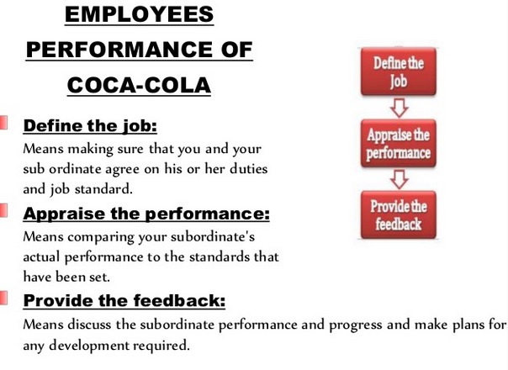
Coca cola

Slide 20
Methods Of performance Appraisal
Traditional Methods Modern Methods
Confidential Reports
Essay Evaluation
Critical incidents
Checklists
Graphic Rating Scales
Forced Choice Method
Ranking
Paired Comparison
Forced Distribution
Group Appraisals
HRA
Assessment Centre
Field Review
MBO
360 Degree Appraisal Method
Behaviorally Anchored Rating Scales

Slide 21
Confidential Reports
It is mostly used in Govt. organizations. It is a descriptive report prepared generally at the end of every year by the employee’s immediate supervisor.
The impression of the immediate supervisor is merely recorded here.
It does not offer any feedback to the employee.
The report states the strengths, weaknesses, sincerity, punctuality, attitude, knowledge, skills, conduct, and character of the employee.

Slide 22
Essay Evaluation
In an essay form appraisal the manager writes a short essay describing the employee's performance.
This form, prepared during the rating period, emphasizes the evaluation of the overall performance on the basis of their strengths/weaknesses.
A major limitation of this method is that the quality of ratings depends on the writing skills of the manager, rather than the performance of an employee.

Slide 23
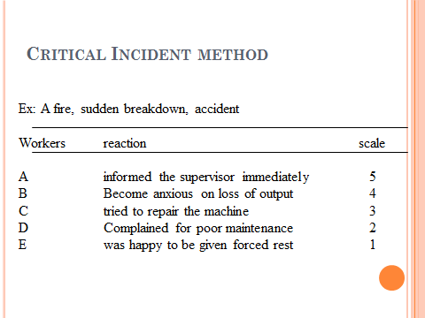
Critical incidents

Slide 24
Checklist method
Simple checklist method
Weighted checklist method
Simple checklist method:
Is employee regular Y/N
Is employee respected by subordinate Y/N
Is employee helpful Y/N
Does he follow instruction Y/N
Does he keep the equipment in order Y/N

Slide 25
Graphic Rating Scales
This is the simplest and most popular technique of performance appraisal
Different parameters of employee behavior and performance are given numerical scales.
The scale might be a five point/level or seven point/level scale.
The rater has to tick against the appropriate performance level on each parameter and then compute the total score of the employee
Advantage
Adaptable to small and large work places
Low cost method
Large number of employees can be appraised in a short time.
Rater does not need any specific training to evaluate
Disadvantages
Biasness is likely to make it way into this method

Slide 26
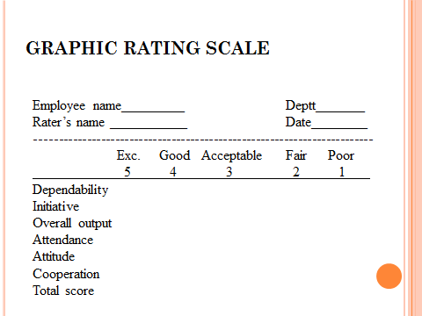
Graphic Rating Scales

Slide 27
Ranking
In this method the superior ranks his subordinates in the order of his or her merit.
This method is likely to have disadvantages like biasness due to halo and horn effect or recency effect.

Slide 28
Paired Comparison
Here each worker is compared with all other employees in the groups for every trait, the worker is compared with all other employees.
For several individual traits, paired comparison are made, tabulated and then rank is assigned to each worker.
Traits are:
behavior
attitudes
Personality
Quantity of work also taken into account

Slide 29
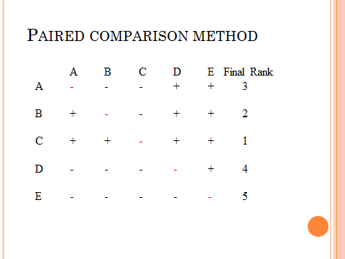
Paired Comparison

Slide 30
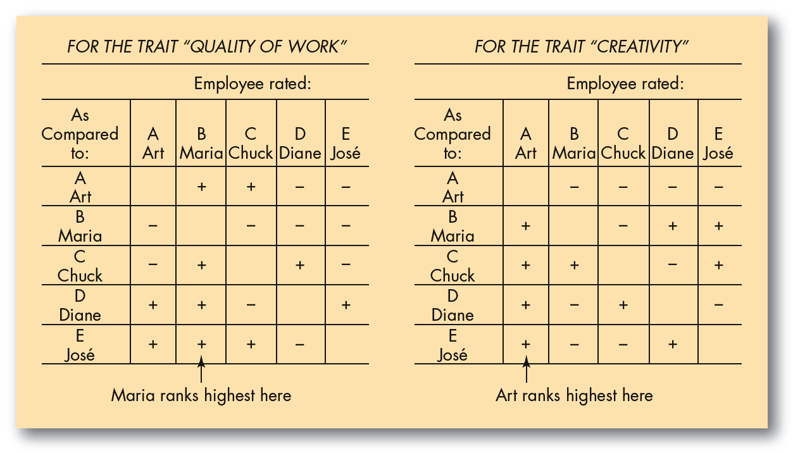

Slide 31
Forced Distribution
In this method , the rater is asked to appraise the employee according to a predetermined distribution scale.
In this, the system rater appraises the employee on two dimensions: job performance and other factors of promotability
(1) effectiveness as a problem solver; (2) the consistent quality of your work; (3) communication skills; (4) attitude on the job—and about the job; and (5) how you promote yourself in the work environment.).
A five-point performance scale is used to describe and classify the employees. The extreme ends denote good and bad performances.

Slide 32
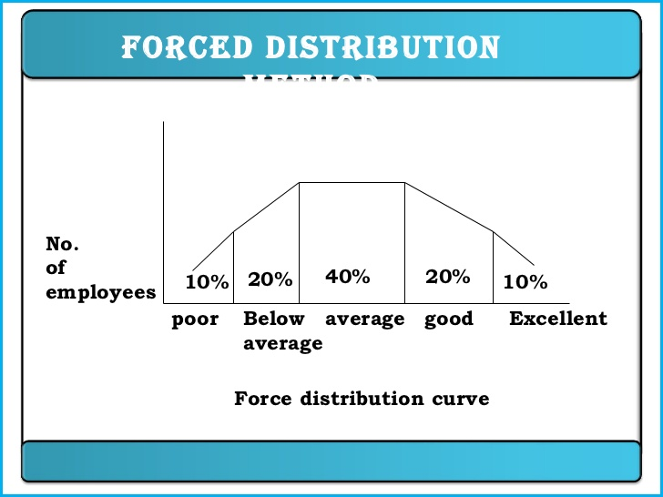

Slide 33
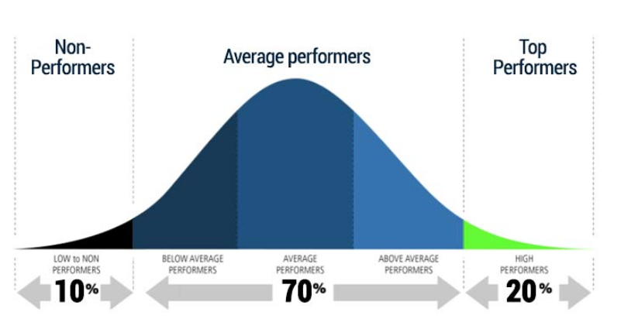
Current appraisal method in it sectors and banks (pvt.)

Slide 34
Modern method
BARS: Behaviourally Anchored Rating Scales
Scales are represented by statements of effective and ineffective behaviour.
Behavioural descriptions exemplifying various degrees of each dimensions serve as anchors on the scale.
Designed to allow superiors to be more comfortable while giving feedback.

Slide 35
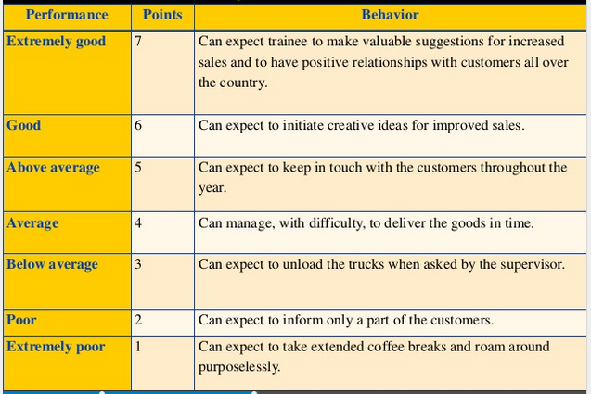
Example of BArs

Slide 36
The Steps in BARS development
GENERATE CRITICAL INCIDENTS : Ask persons who know the job (job holders, supervisors) to describe specific illustrations of effective and ineffective performance.
DEVELOP PERFORMANCE DIMENSIONS : Have them cluster the incidents into a smaller set of 5 or 10 performance dimensions, and define each dimension.
❖ REALLOCATE INCIDENTS : Another group of people who also know the job then reallocate the original critical incidents.
DEVELOP A FINAL INSTRUMENT : choose about 6 or 7 of the incidents as the dimension's behavioural anchors.

Slide 37
Performance dimension = length + breadth + depth + height
Quantity of work i.e. volume of work completed by employees – recognises hard-working employees.
Timeliness of work i.e. timely delivery of work in terms of schedules, meeting deadlines, etc. – recognises employees who produce work on-time and meet deadlines.
Quality of work i.e. the quality of work produced in terms of standards, errors, waste and rework – recognises employees who produce work which meets standards and work with few errors or mistakes.
Self-Reliance i.e. recognises employees who produce work without the need for extensive supervision – requires a reasonable level of support.

Slide 38
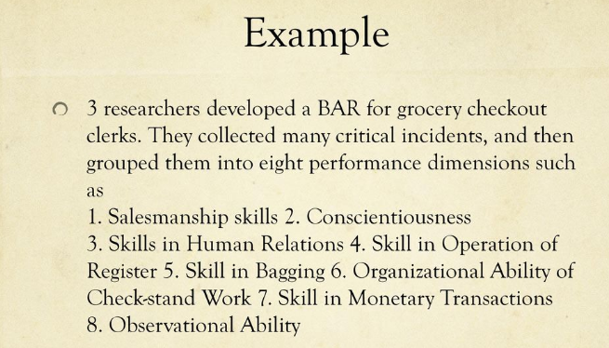

Slide 39

360 degree appraisal
In a 360 degree appraisal, a staff member's work for a specific period of time, often a year, is discussed and critiqued by other employees. The 360 degree process is different, in that it obtains feedback from co-workers and subordinates, instead of just from the direct supervisor.

Slide 40
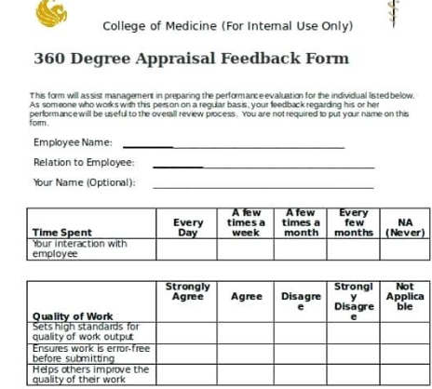
How does it work ?
Most often, information solicited in a 360-degree feedback process will include feedback from an employee's subordinates, peers (colleagues), and supervisor(s), as well as a self-evaluation by the employee him or herself.

Slide 41
Assessment centre
An Assessment Center consists of a standardized evaluation of behavior based on multiple evaluations including:
job-related simulations,
interviews, and/or psychological tests.
Job Simulations are used to evaluate candidates on behaviors relevant to the most critical aspects (or competencies) of the job.

Slide 42
Assessment centre
Role Play: A role-play exercise is an assessment activity in which candidates act out an imaginary scenario that closely mirrors a situation that could occur in the job they have applied for.
often this will be the line manager for one of the roles that’s being recruited.
The employee will be given a briefing document that outlines the scenario and your objectives and will be given 20-30 minutes to prepare.
At the end of the exercise you will be scored on your performance and that feedback will be factored in to the cumulative results of the interview/assessment centre.
Example role-play exercise 1 – The Angry Customer
“You are the sales manager of a small firm. You receive a telephone call from an angry customer who bought a home security system from your company but is not happy with it. They are now threatening to take their story to a consumer watchdog and to the trading standards ombudsman. Your objective is to resolve the issue with the minimum damage to the company (both financially & in terms of our reputation). Plan your response and prepare to call the customer.”

Slide 43
Assessment centre
The in-tray exercise: it helps the rater to know how the ratee (employee) would approach a typical workday scenario.)
The in-tray exercise is an assessment activity that’s widely used by employers to measure candidates’ suitability for a job.
It’s a business simulation where you play a member of staff who has to deal with the workload of a typical day.
What does the in-tray exercise measure?’
The in-tray exercise measures your analytical skills, communication skills, written skills, delegation skills and business acumen. At the beginning of your in-tray exercise you will receive background information about the imaginary scenario to help build a clearer picture and to give you context.

Slide 44
Field review and hra method
Field Review Method: Here the one of the assessor rom corporate office will assess the performance of employees.
Here the assessor reviews the records and hold an interview with the rate.
It is primarily use for promotional decision at the managerial level.
HRA / Cost Accounting Method: this method evaluates performance from the monetary returns the employee yields to his or her organisation.

Slide 45
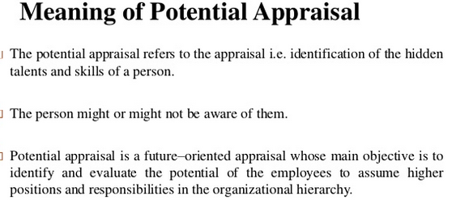
Potential appraisal

Slide 46
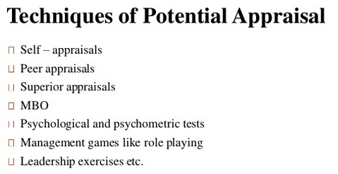
What are the techniques for potential appraisal

Slide 47
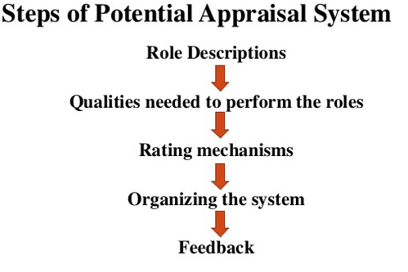

Slide 48
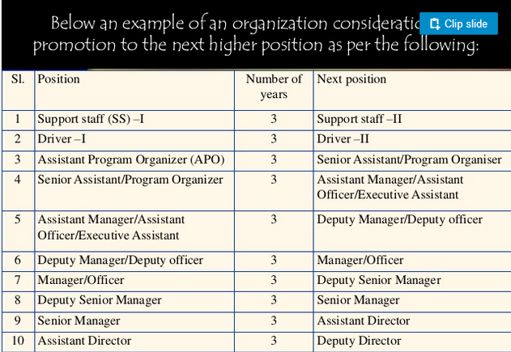

Slide 49
Errors / BIASES in appraisal
Error type | features
Halo effect | Tendency to assess of a single trait
Horn effect | Tendency to allow one negative trait- result in overall rating low
Leniency | Depending upon appraiser’s own value system.
Central tendency | Rater assigns mainly middle range scores or values to all individual.
Spill-over effect | Refers to allowing past performance to influence the evaluation.
Personal bias | Very few people have judgment capability which is impartial.
Recency effect | The rater gives greater weightage to recent occurrences than earlier performance.
Stereotyping | It is a mental picture that an individual holds about a person because of the person’s age, religion, caste.

Slide 50
600 Wipro employees sacked after performance appraisal: A case of WIPRO
Wipro is learnt to have sacked 600 employees as part of its annual ‘performance appraisal’, at a time when IT firms are facing curbs on work visas in US and Australia. (April- 2017)
At the end of December 2016, the Bengaluru-based company had over 1.79 lakh employees.
WIPRO conducts "rigorous performance appraisal process” on a regular basis to align its workforce with business objectives, strategic priorities of the company, and client requirements.
“The performance appraisal may also lead to the separation of some employees from the company.
Wipro has comprehensive performance evaluation process includes mentoring, re-training and upskilling of employees.

Slide 51
Wipro Ditches Bell Curve Method Of Performance Appraisal
Wipro is moving with the times.
the IT services giant Wipro is breaking away from convention and doing away with the Bell Curve method of employee appraisal.
Last year Infosys, CISCO, KPMG and Accenture had also discarded this system of employee appraisal.
Under the Bell Curve method, managers try to assign employees into predetermined groups according to their performance, potential, and promotability.
Wipro’s reason for this change was purportedly to make the employees, mid-level executives and top managers more accountable for the company’s performance.
Wipro is now implementing a new evaluation system where feedback will be more frequent and quarterly. They wanted to make the process of giving feedback more frequent and the performance management system to be an ongoing coaching based process.

